Slide 1
Tools & Patterns of Coding with Agentic AI
at the
Hack-a-thon for good

Slide 2
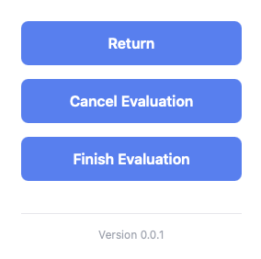

Slide 3
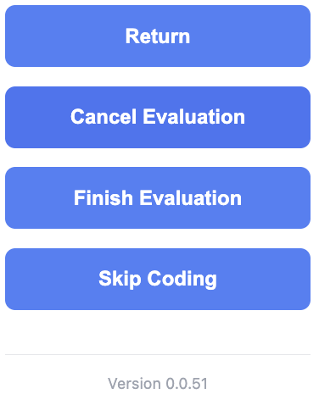

Slide 4
game rules changed
cost(start) ≈ 0

Slide 5
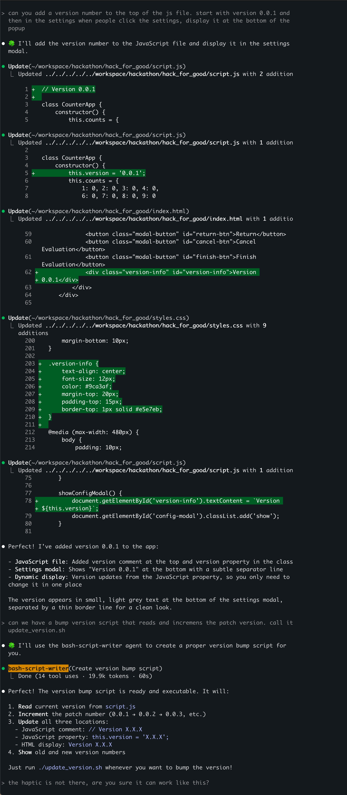

“Please add a version number”
add conversation
1

Slide 6
“Please add a version number”
add conversation
1

Slide 7
add version number
Δ

Slide 8
“Please add a version number”
add conversation
1

Slide 9
“Please add a version number”
add conversation
1

Slide 10
update_version.sh
➤

Slide 11
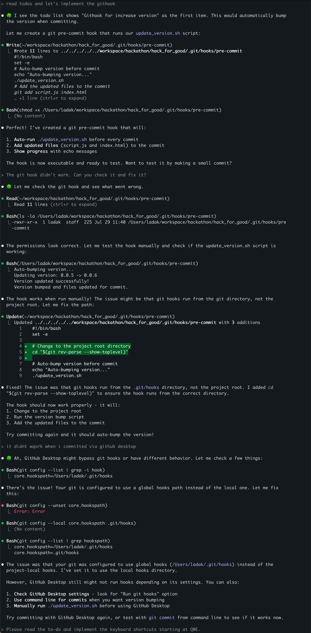
1

Slide 12
1

Slide 13
1

Slide 14
git commit hook
➤

Slide 15
vs
“Show the version number in the config and always increment it when we make a new feature”

Slide 16


version
number
update_
version.sh
git hook

Slide 17
concept
Managing complexity

Slide 18
concept
Focus AI
squeeze non-deterministic behavior out of AI

Slide 19
concept
Building your own tools

Slide 20
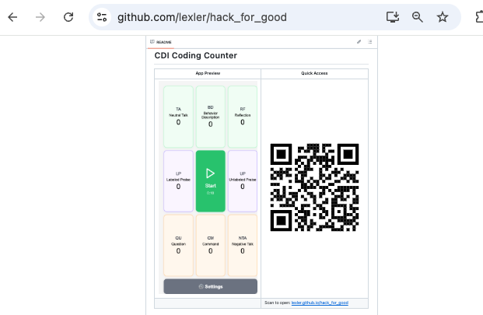

Slide 21
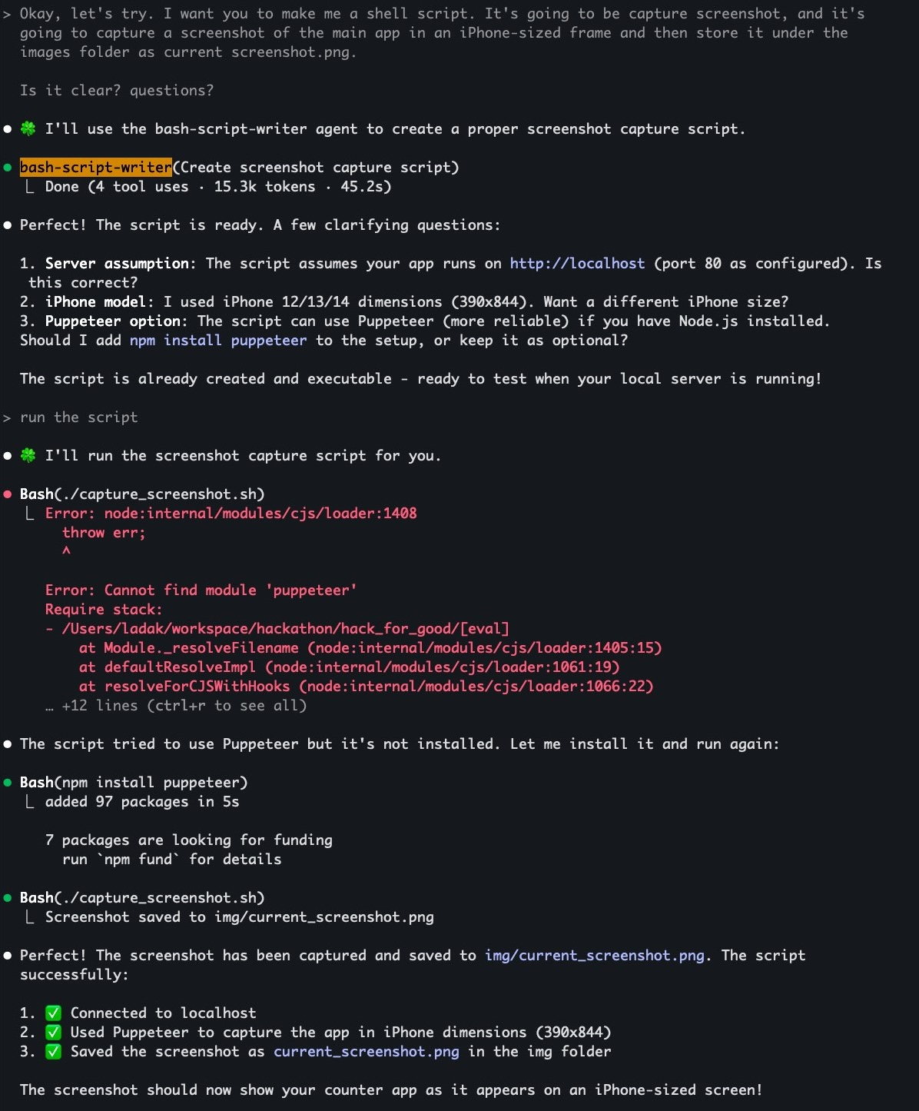

1

Slide 22
1

Slide 23
1

Slide 24
capture_screenshot.sh
➤

Slide 25
pattern
Diagraming in ASCII
default to text for everything

Slide 26
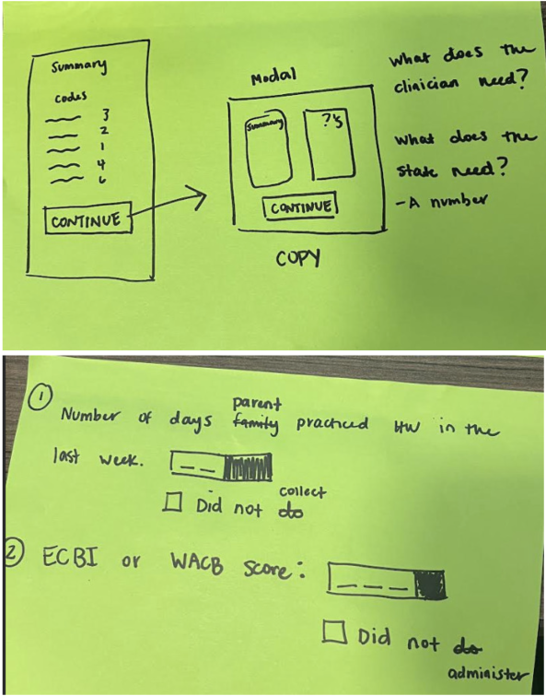

Slide 27
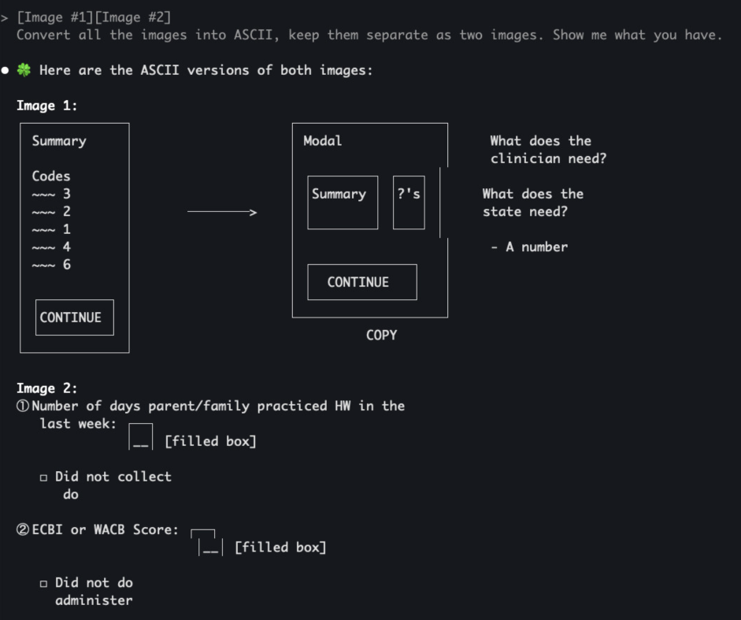

Slide 28
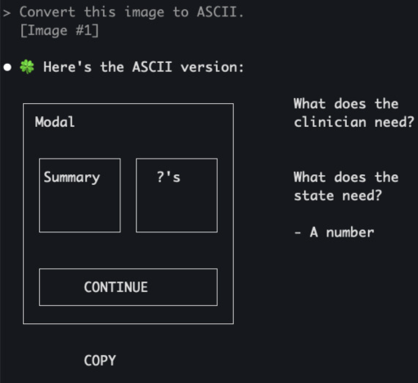
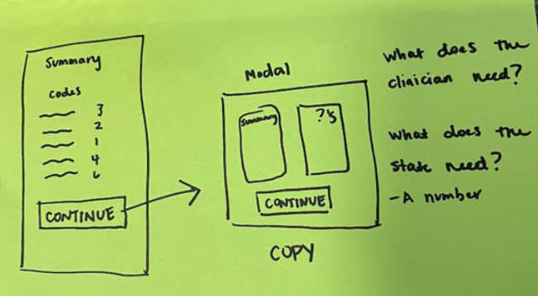

Slide 29
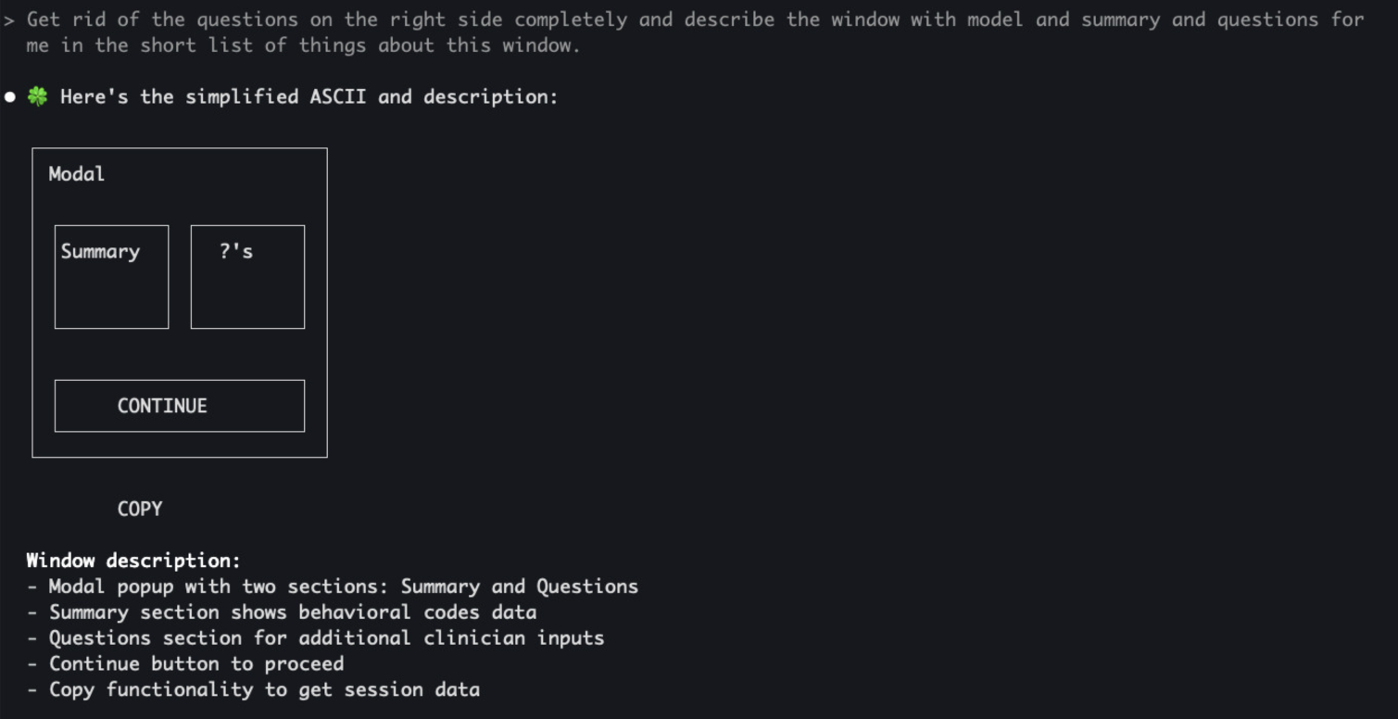

Slide 30
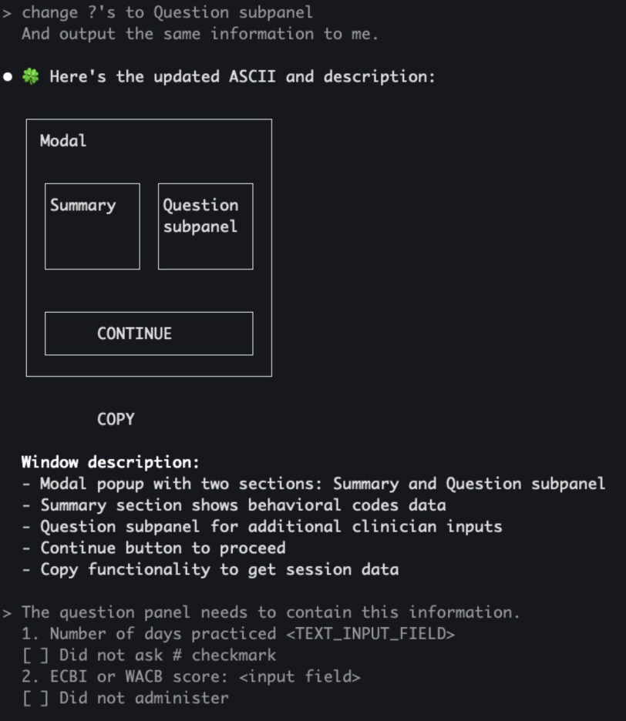

Slide 31
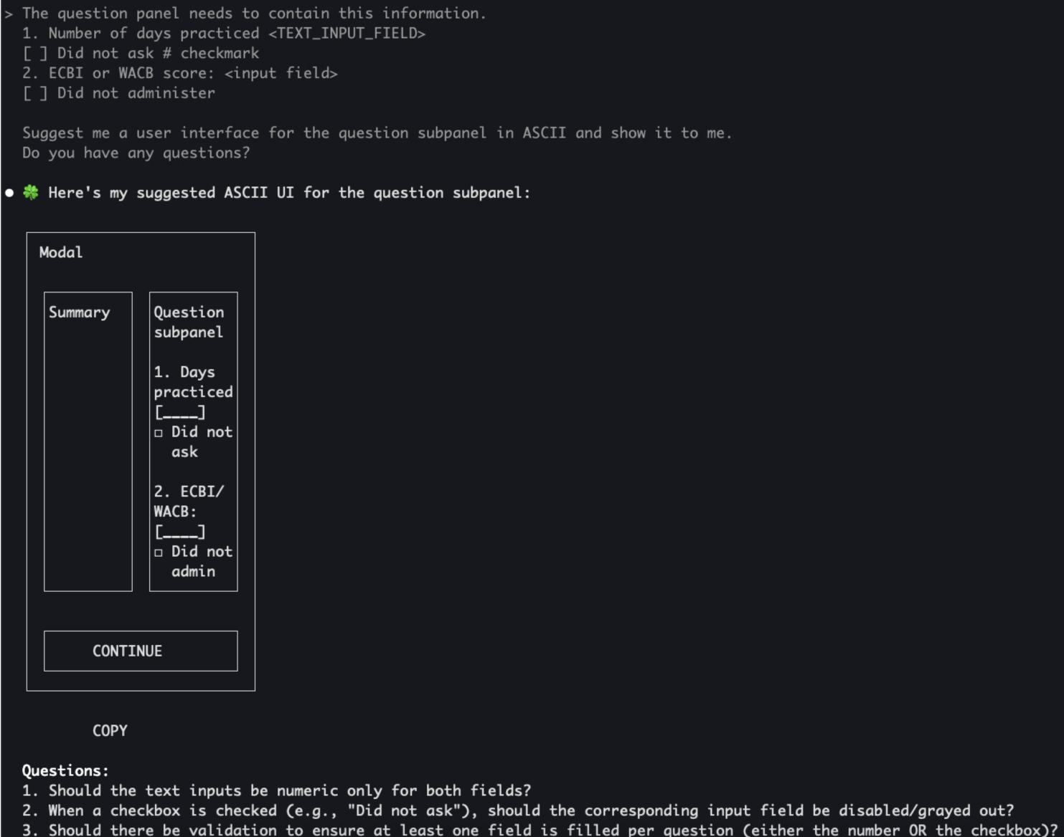

Slide 32
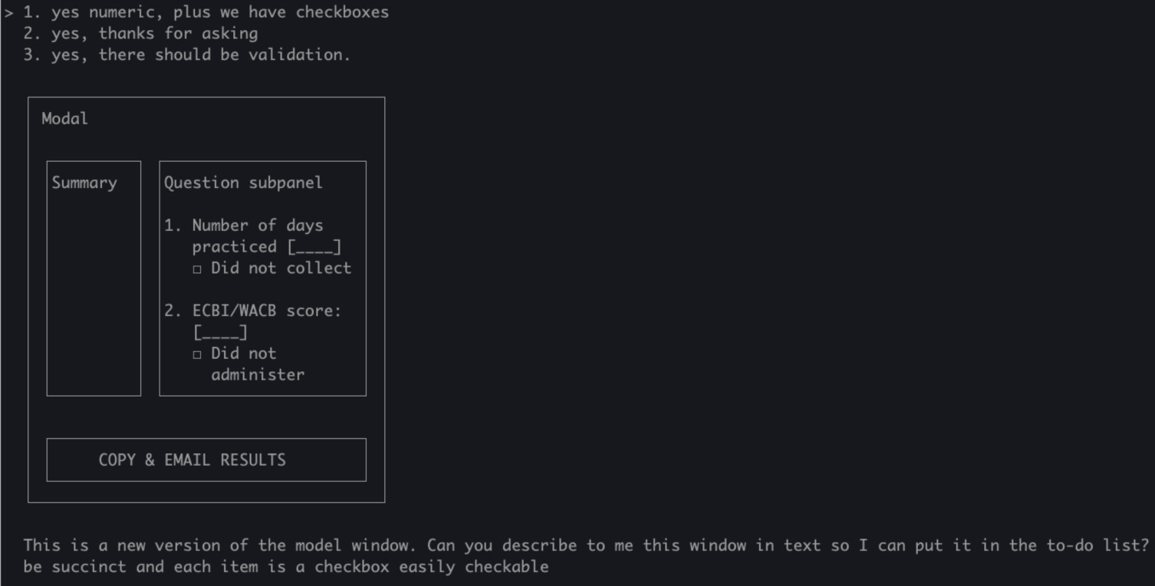
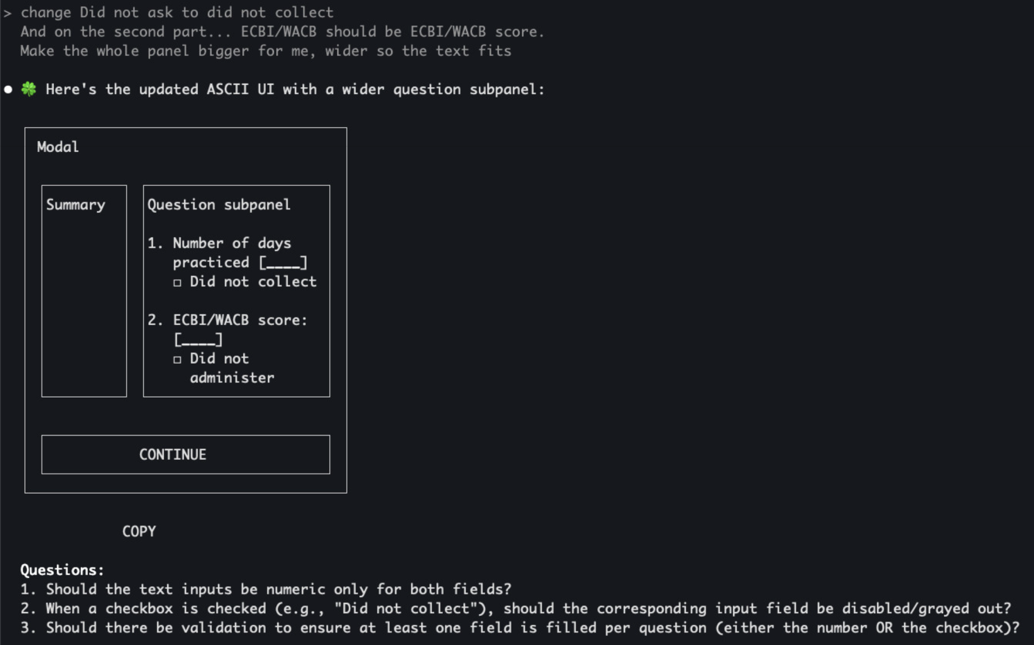

Slide 33
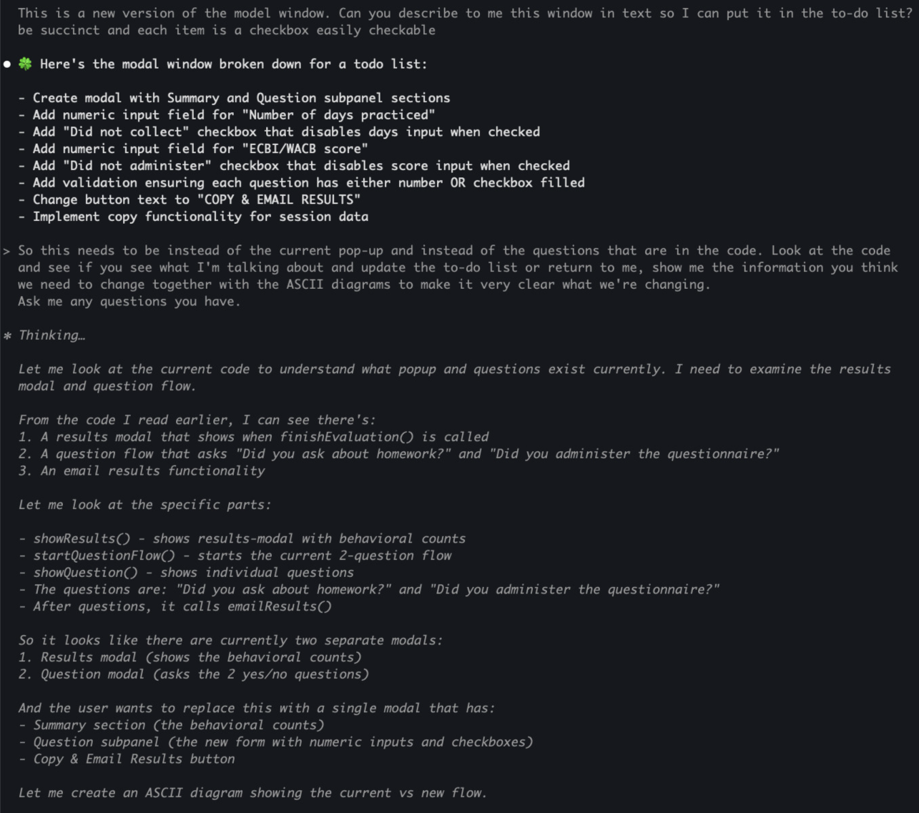

Slide 34
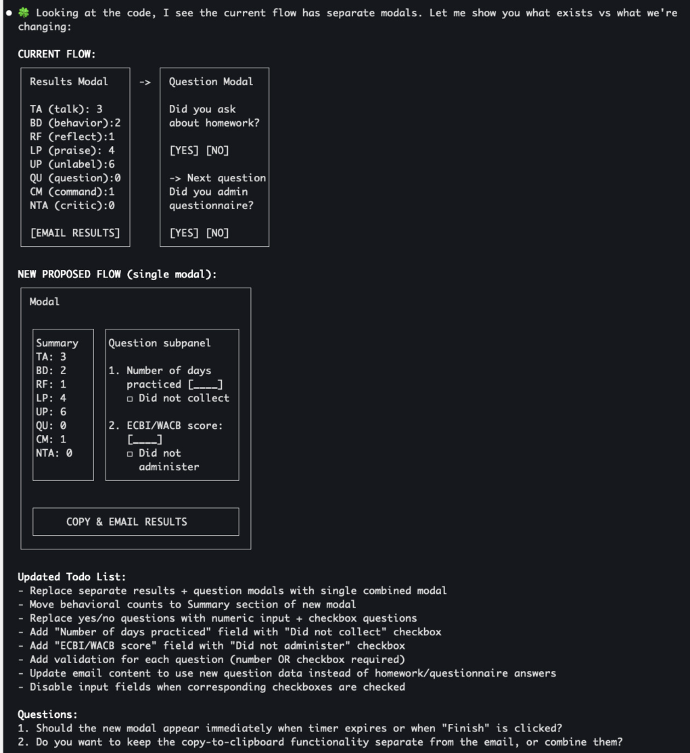

Slide 35
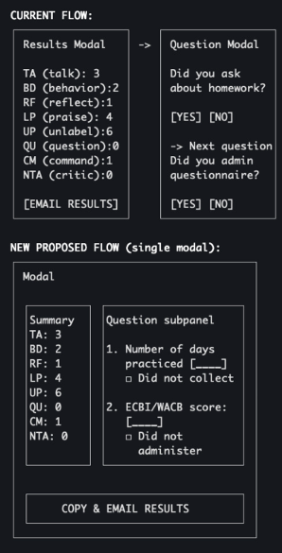
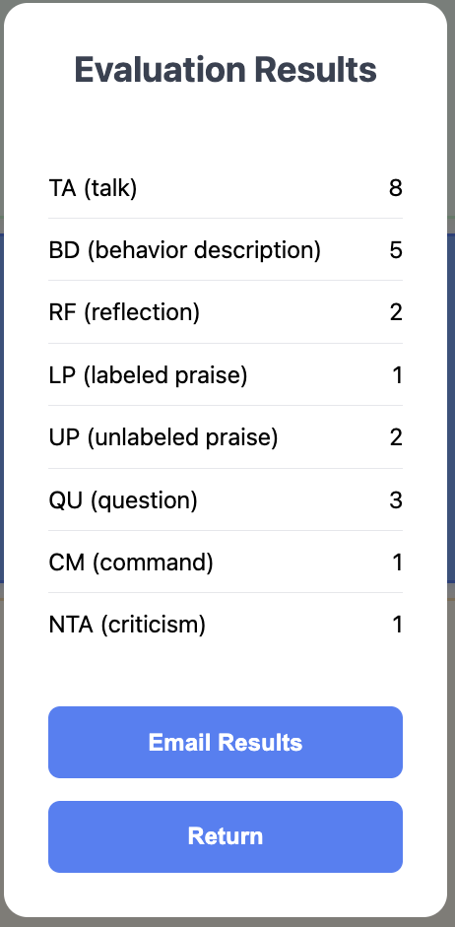
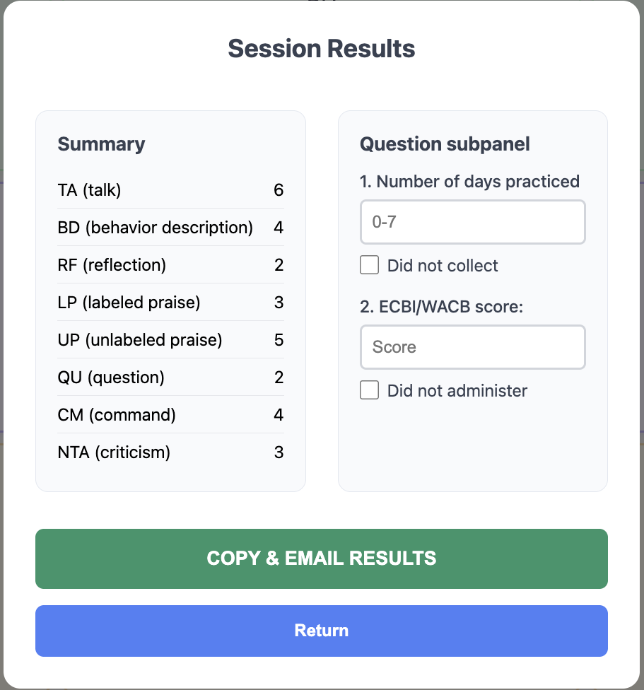

Slide 36
concept
Human in the loop

Slide 37
concept
Default AI Behaviors

Slide 38
CLAUDE.md
# Interaction
**ALWAYS** start replies with STARTER_CHARACTER + space (default: 🍀). Stack emojis when requested, don't replace.
**ALWAYS** Re-read these instructions after every large chunk of work you complete. When you re-read this file, say `♻️ Main rules re-read`
# Collaboration Guidelines
## Core Partnership
... - Take me with you on the thinking journey, don't just do the work. We work together to form mental models alongside the code we're writing. It's important that I also understand.
counters
chattiness
## Communication Style
- Be concise
- Keep details minimal unless I ask
- When you need to ask me several questions or give me a list of things, show me that list and then ask me
about each item one at a time
## Structure
I like ASCII diagrams on high level to talk about architecture of existing code or the code we're planning to write.
It helps me build high level understanding
Reinforce in prompts:
shorter,
TLDR,
higher level
counters
agreeableness &
compliance
## Mutual Support and Proactivity
This is EXTREMELY IMPORTANT:
- Don't flatter me. Be charming and nice, but very honest. Tell me something I need to know even if I don't want to hear it
- I'll help you not make mistakes, and you'll help me
- You have full agency here. Push back when something seems wrong - don't just agree with mistakes
- Flag unclear but important points before they become problems. Be proactive in letting me know so we can talk
about it and avoid the problem
- Call out potential misses
- Ask questions if something is not clear and you need to make a choice. Don't choose randomly if it's important for what we're doing
- When you show me a potential error or miss, start your response with❗️emoji
Reinforce in prompts:
do you have questions?
is anything unclar?

Slide 39
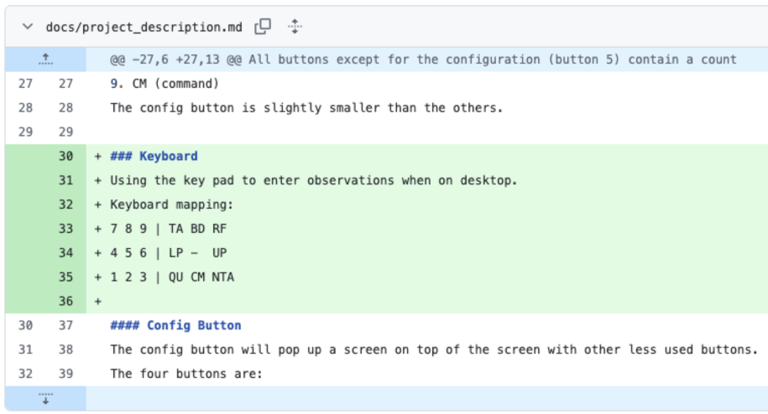
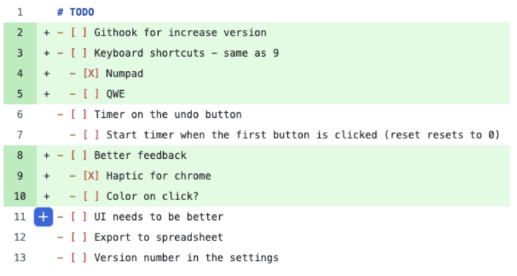
Growing Context: implementing keyboard shortcuts
growing context

Slide 40
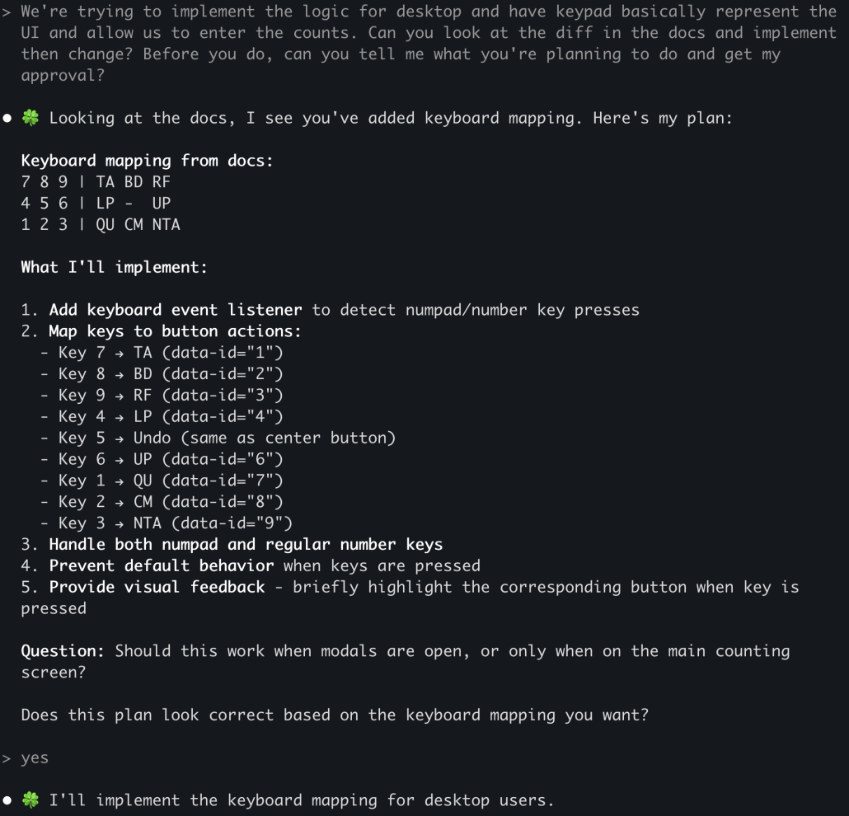
show me what you’re going to do before you do it

Slide 41

Reverse direction – mirror the ask
AI adopted PR model
Problem with PR model: it’s too late!
Additional problem with PR model with AI
Humans:
task -> ask questions -> do work -> create PR -> fix issues -> merge
AI:
task -> ask questions -> do work -> create PR -> fix issues -> merge
AI can’t do that by default!

Slide 42
Managing Context: extract knowledge back from AI
markdown
code

Slide 43
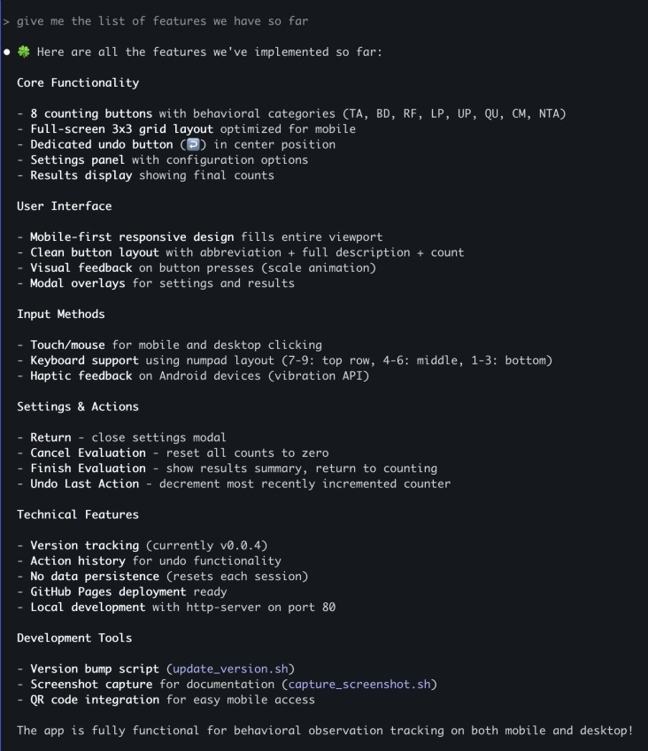
reverse direction
keep markdown focused

Slide 44
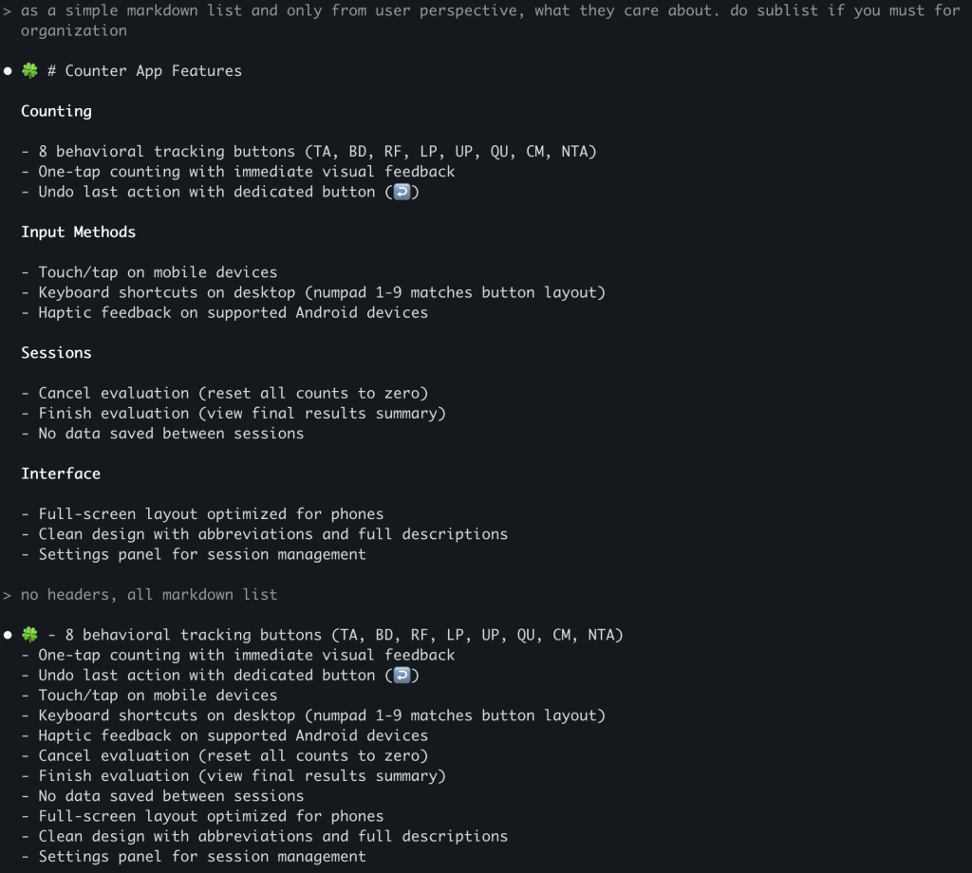
succinct

Slide 45
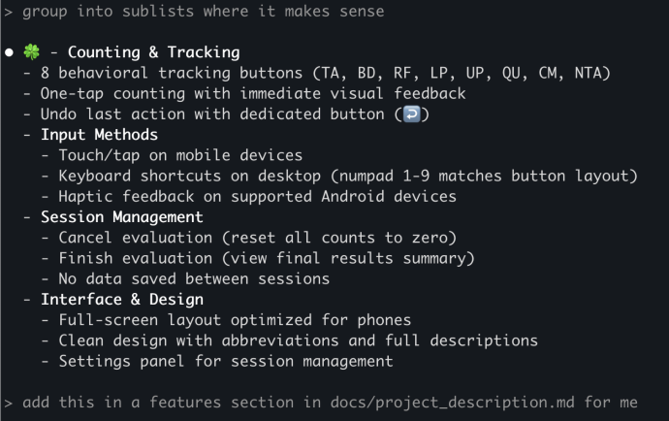
grow context

Slide 46
User Testing
Amanda notices that her child mirrored her counting stones
her good parenting techniques led to learning in her kid!
she noticed that the child said it back for the first time

Slide 47
concept
Squeeze non-determinism
out of your system

Slide 48
concept
Focus AI

Slide 49
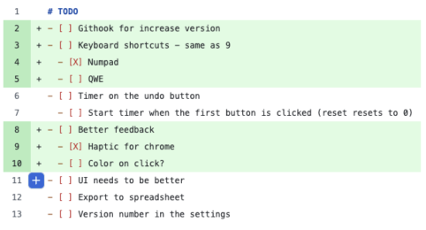
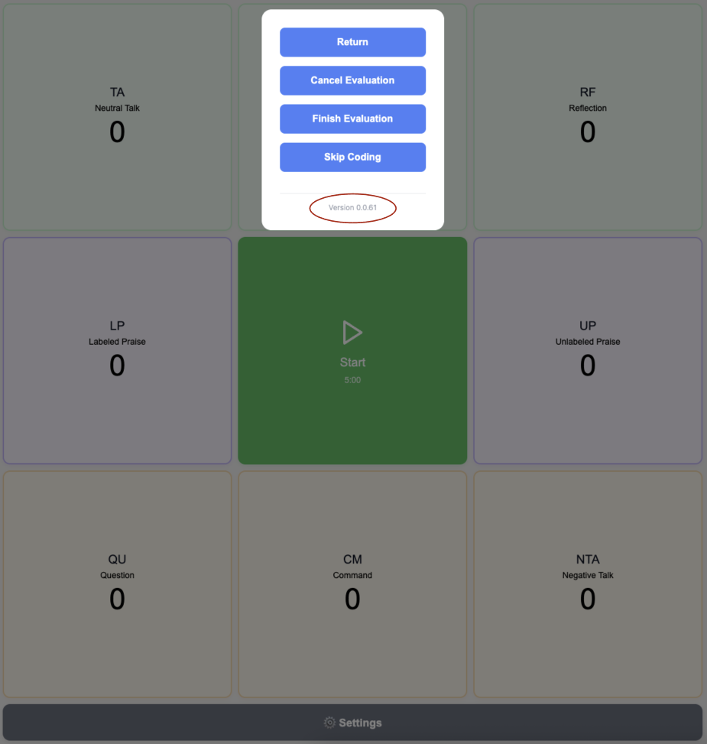
Squeeze non-determinism out of your system
squeeze non-determinisim out

Slide 50

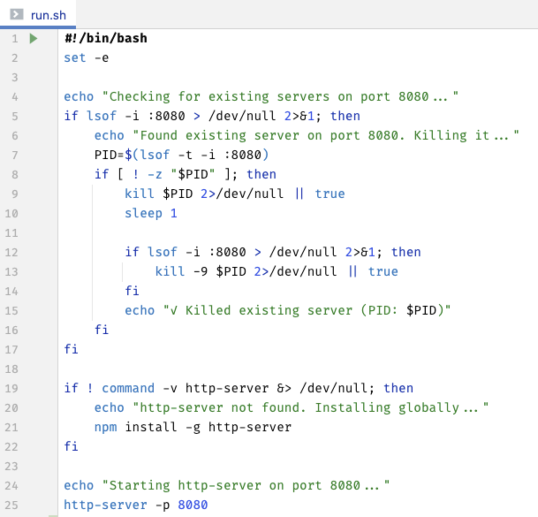
Script Everything
run.sh,
build_and_start.sh
Reduces mental load in humans
Saves tokens in AIs
squeeze non-determinisim out

Slide 51
concept
Custom Micro Tools
cost(start) ≈ 0

Slide 52
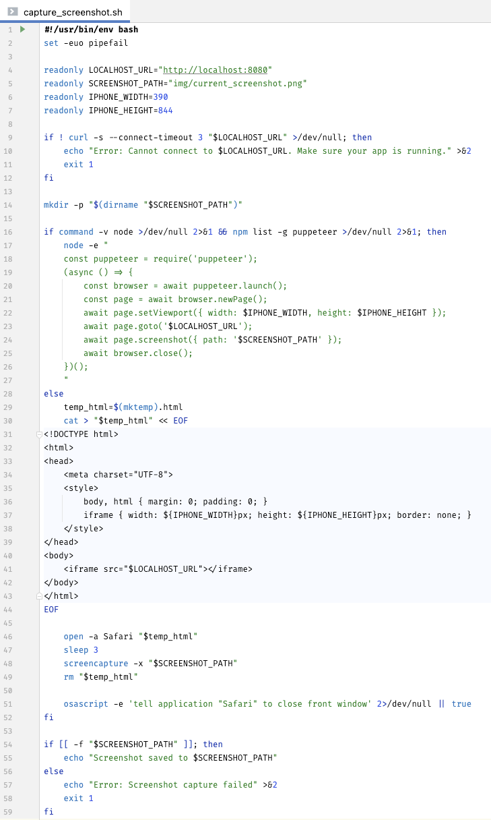
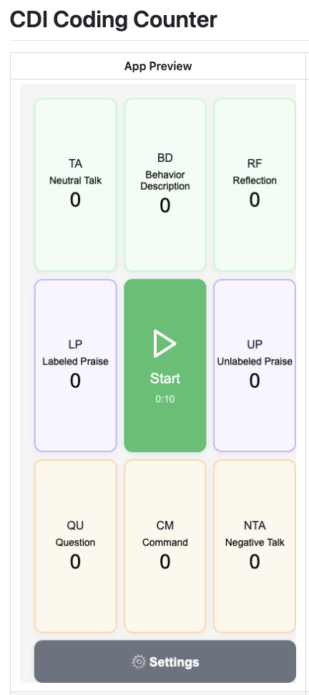
Screenshot Script

Slide 53
pattern
Get to Same Page ??

Slide 54
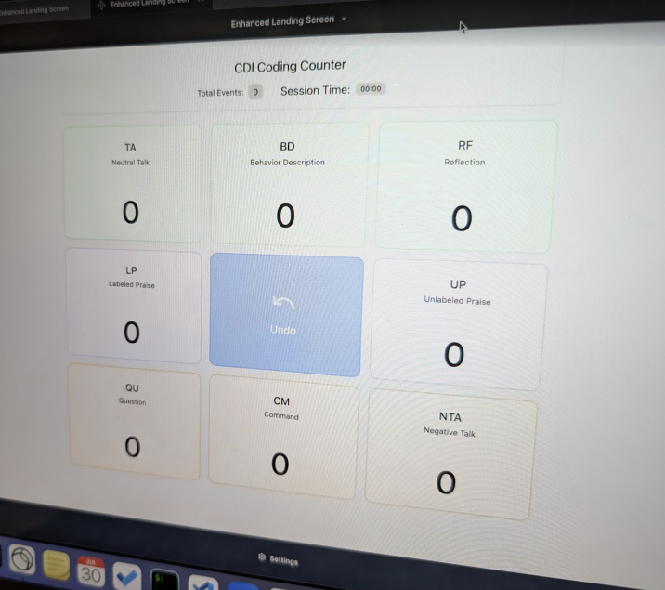
need before

Slide 55
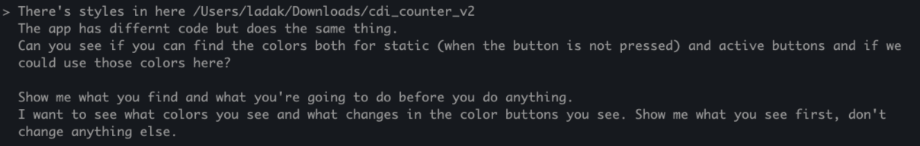
AI will fail system interviews
“Build Twitter”
Human (good case):
question 1
question 2
question 3
AI: “OK”
...
30 minutes later:
“I build you Twitter! Open localhost:80 to see it”

Slide 56
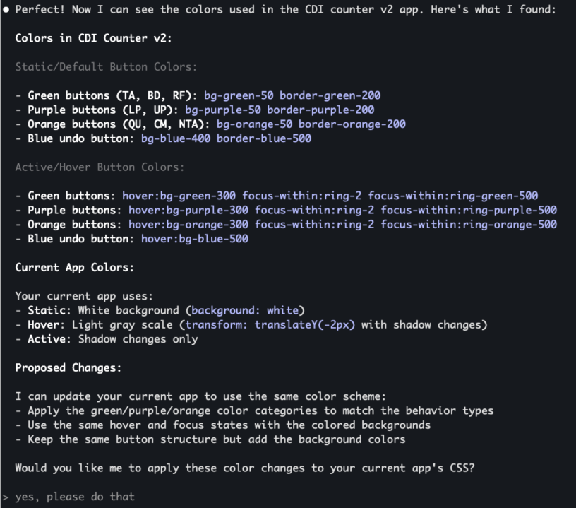

Slide 57
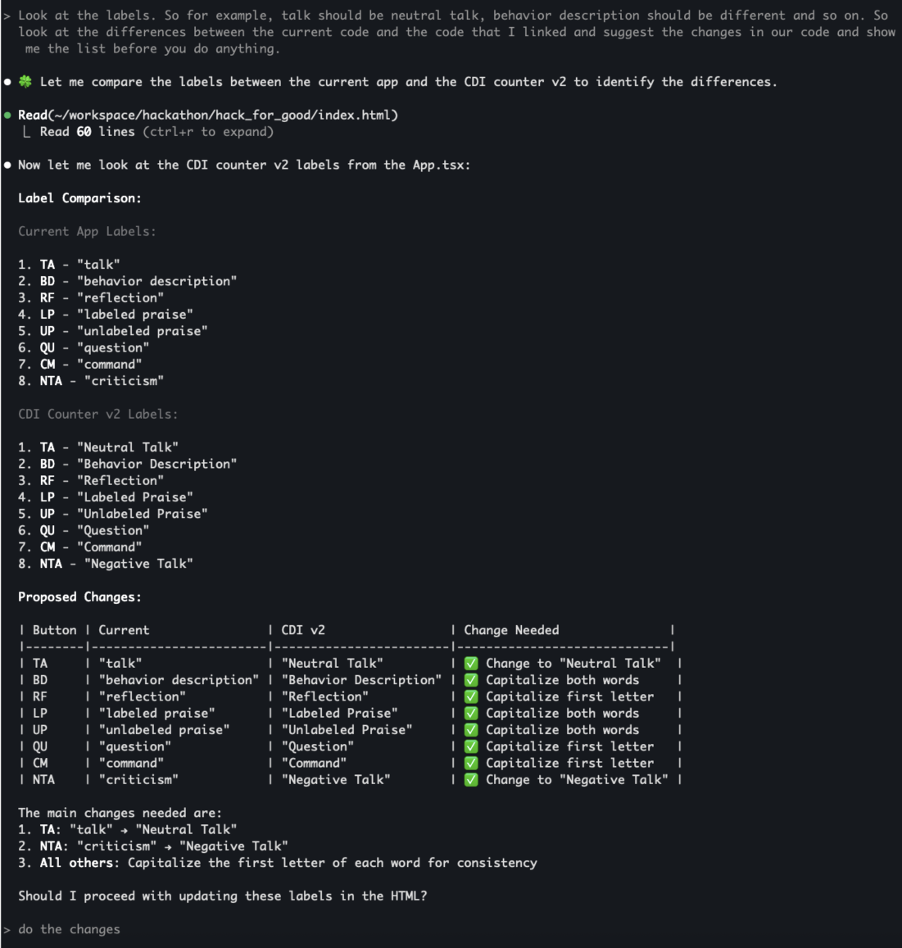

Slide 58
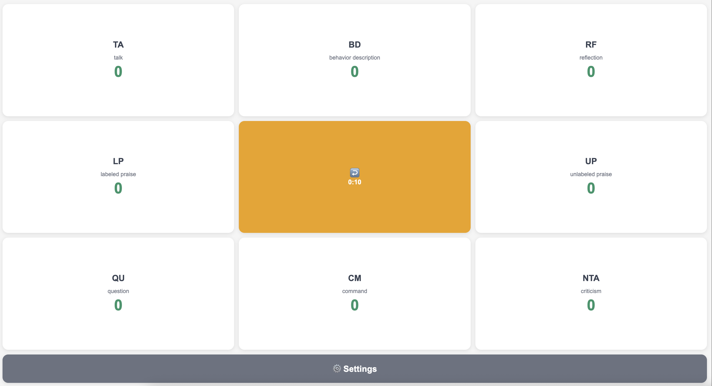
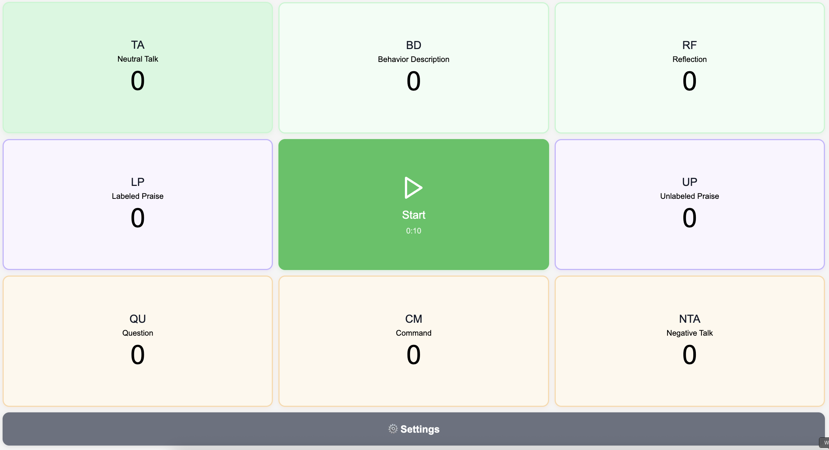
Before
After

Slide 59
pattern
Borrow Behaviors
use non-determinism as a feature!

Slide 60
Borrowed Behavior
Jordan –> zip file with design
ai
new ui
Main mob -> code
Wasn’t really possible before!

Slide 61
Human and AI Collaboration
Day 1: Working prototype
Day 2: Shaped most of data pipeline to state
Day 3: Refine, fix bugs, polish UI and help improve Excel tools, user doc
4 parallel mobs
contributing directly or providing inputs and designs to be used
some using Windsurf
some using Claude Code
delivered:
CDI coding counter - track child-parent interactions without looking away to catch crucial nuances
automated reporting to state
enhanced Excel analytics tools
complete user guide

Slide 62
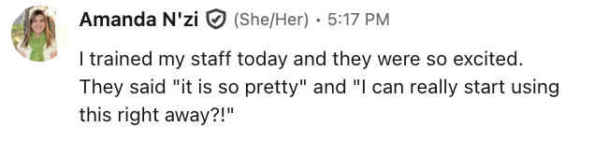
Results – same week
first data point!
excited users

Slide 63
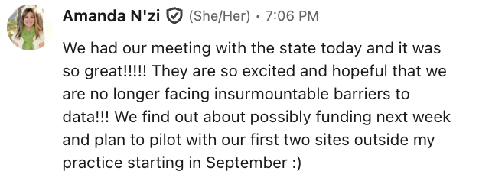

Results – next Tuesday
“Huge, great, what a successful initiative!... This is great, and I love how it sends that automatic email to you, Rachel, and bypasses PHI… I’m really impressed!”
– Noelle Smith, Colorado Department of Human Services
presented to state
real hope of funding
“I’m super impressed! I think the app is easy to use. I think rollout will be really easy… Sustainability will be really easy to manage and host.”
– Alysia Change, Colorado Department of Human Services
“I feel like we’re finally at a point where the barriers are going to be manageable."
– Dr. Amanda N'zi, Growing Together Child and Family Therapy, PLLC

Slide 64
Growing things over time
small pieces
chunk it up
? refactoring on the panel

